Slide 1
Slides for Chapter 3
Note to Instructors
This Keynote document contains the slides for “The Sieve of Eratosthenes”, Chapter 3 of Explorations in Computing: An Introduction to Computer Science and Python Programming.
The book invites students to explore ideas in computer science through interactive tutorials where they type expressions in Python and immediately see the results, either in a terminal window or a 2D graphics window.
Instructors are strongly encouraged to have a Python session running concurrently with Keynote in order to give live demonstrations of the Python code shown on the slides.
License
The slides in this Keynote document are based on copyrighted material from Explorations in Computing: An Introduction to Computer Science and Python Programming, by John S. Conery.
These slides are provided free of charge to instructors who are using the textbook for their courses.
Instructors may alter the slides for use in their own courses, including but not limited to: adding new slides, altering the wording or images found on these slides, or deleting slides.
Instructors may distribute printed copies of the slides, either in hard copy or as electronic copies in PDF form, provided the copyright notice below is reproduced on the first slide.
© 2015 John S. Conery

Slide 2
The Sieve of Eratosthenes
An algorithm for finding prime numbers
The Sieve Algorithm
Lists
Iterating Over Lists: for Statements
List Indexes
The Animated Sieve
A Helper Function
The sieve Function

Slide 3
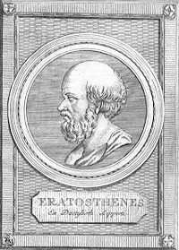
History
Prime numbers have a long and interesting history
a number is prime if it cannot be written as the product of two smaller numbers
non-prime numbers are called composite numbers
these are primes: 5, 11, 73, 9967, ...
these are composite: 10 (2 × 5), 99 (3 × 3 × 11), ...
Ancient Greek, Persian, and Chinese philosophers all studied properties of prime numbers
the Sieve of Eratosthenes, the algorithm we’re looking at today, is one of the oldest known algorithms
dates to at least 200 BC
See http://primes.utm.edu

Slide 4

Motivation
Until the middle of the 20th century prime numbers were of interest only to number theorists
In 1970 a new method for encrypting messages was invented
the security of the RSA algorithm relies on the difficulty of finding the factors of large numbers
here “large” means numbers with 500 digits or more
RSA has renewed interest in properties of prime numbers and methods for generating them

Slide 5
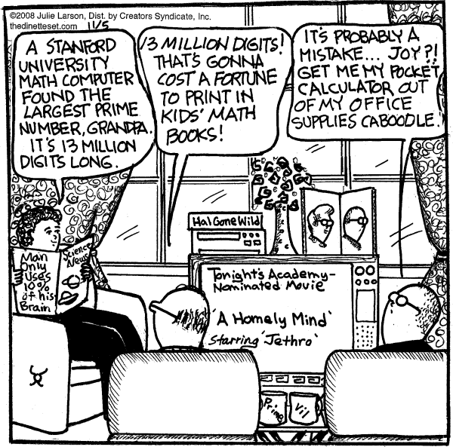
Big Number
UCLA
In Aug 2008 a project named GIMPS (Great Internet Mersenne Prime Search) set a new record
the largest known prime number is now 2⁴³¹¹²⁶⁰⁹ - 1
around 13 million digits
the group that found it claimed a $100,000 prize....
At 10 digits/inch:
12” thick book, or
a string 20 miles long
“The Dinette Set” by Julie Larson

Slide 6
Goals
In this chapter we will
see how the Sieve of Eratosthenes creates lists of prime numbers
learn to create and manipulate lists of objects in Python
apply what we learn about lists as we work through a complete implementation of the Sieve of Eratosthenes
At the end of the chapter there are several suggestions for programming projects you can do on your own
some involve using the sieve function implemented in this chapter
others have you use lists to solve problems of comparable difficulty

Slide 7
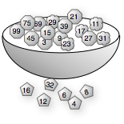
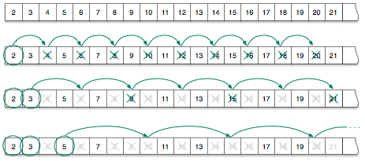
The Sieve
The basic idea is simple:
make a list of numbers, starting with 2
repeat:
the first unmarked number in the list is prime
cross off multiples of the most recent prime
initial list
round 1
round 2
round 3

Slide 8
Technology
The method described on the previous slide works well for short lists
But what if you want to find prime numbers between 2 and 100? 1000?
it’s a tedious process to write out a list of 100 numbers
takes a lot of paper to make a list of 1000 numbers
chances are you will make a few arithmetic mistakes (this is a boring job)
You could improve accuracy by using an abacus or calculator
but it’s still very boring....

Slide 9
Technology (cont’d)
Can we turn this method into a computation?
detailed specification of starting and ending conditions are there
What about the steps?
“cross off” and “next number” need to be defined if we’re going to use Python
when do we stop the process? when all the numbers are crossed off?

Slide 10
A Python Function
The project for this chapter shows how to create a Python program that implements the Sieve of Eratosthenes
When we’re done we will have a function named sieve
pass it a number n
it will return a list of prime numbers less than n
>>> sieve(20) [2, 3, 5, 7, 11, 13, 17, 19]
>>> sieve(2000) [2, 3, 5, 7, 11, 13, 17, 19, 23, 29, …, 1987, 1993, 1997, 1999]

Slide 11
Container Objects
In everyday life we often encounter collections
course catalog -- collection of course descriptions
car lot -- collection of cars
Mathematicians also work with collections
matrix
sequence (e.g. 1, 1, 2, 3, 5, 8, ...)
In computer science we make a collection by defining a “data structure” that includes references to other objects
Using programming terminology an object that holds references to other objects is a container
items in a container are objects
the container itself is also an object

Slide 12
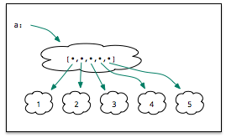
Lists
The simplest kind of container in Python is called a list
One way to make a list is to enclose a set of objects in “square brackets”
>>> a = [1,2,3,4,5]
This statement is an assignment just like those we saw previously
Python allocates space in its “object store”
creates an object to represent the list, associates the name a with the new object

Slide 13
Operations on Lists
If we ask Python what a is, it shows us it’s a list:
>>> a [1, 2, 3, 4, 5]
The len function tells us how many items are in list:
>>> len(a) 5
len stands for “length”

Slide 14
Lists of Strings
Any kind of object can be stored in a list
This statement defines a list with 2 strings:
>>> breakfast = ['spam', ‘eggs']
Note what happens when we ask Python how many objects are in this list:
>>> len(breakfast) 2
Python did not count the individual letters
the list contains 2 string objects, so the result of the call to len is 2

Slide 15
Empty Lists
We can also make a list with no objects
>>> e = []
The value on the right side of that expression is a valid list
a list is still a list, even if it contains no objects
a notebook is still a notebook, even if it contains no pages
As expected, the length of this list is 0:
>>> e []
>>> len(e) 0

Slide 16

Iteration
After building a container we often want to do something with each item
The idea is to “step through” the container to “visit” each object
This type of operation is called iteration
from the Latin word iter, for “path” or “road”
To find the largest item in an (unsorted) list an algorithm needs to visit each item

Slide 17
for Statements
The simplest way to “visit” every item in a list is to use a for statement
This example prints every item in the list a
for x in a:
print(x)
Python assigns x to be the first item in the list and then executes the indented statement(s)
Then it gets the next item, assigns it to x, and executes the indented statement(s) again
It repeats until all the items in list have been processed
Important: all the statements in the “body” of the loop must be indented the same

Slide 18
Example
The function shown at right will compute the total of all the numbers in a list
It initializes a variable named sum to be 0
The loop adds each number in a to sum
After all items have been added the loop terminates and the statement on line 5 returns the final sum
The statement
sum += x
means “add x to the value of sum”

Slide 19

List Indexes
We often want to find an item in the middle of a list
If a list has n items, the locations in the list are numbered from 0 to n-1
The notation a[i] stands for “the item at location i in list a”
Example:
>>> a = ['a', 'e', 'i', 'o', 'u']
>>> a[0] 'a'
>>> a[2] 'i'
>>> a[4] 'u'

Slide 20
List Indexes (cont’d)
If we try to access an item past the end of the list it is an error
>>> a[6]
IndexError: list index out of range

Slide 21
Iteration Using List Indexes
A common programming “idiom” uses a for loop based on a list index
for i in range(n):
...
Python executes the body of the loop n times
i is set to every value between 0 and n-1
Example: the partial_total function computes the sum of the first n values in a list

Slide 22
Outline
We now have all the pieces we need to make a list of prime numbers
use a Python list object to represent the “worksheet”
it will initially have all the integers between 2 and n (the upper limit)
use for loops to “walk through” the list to mark composite numbers

Slide 23
Making Lists of Numbers
The range function (which we used earlier in a for statement) can also be used to make lists of numbers
This example makes a list of the numbers from 0 to 9:
>>> list(range(10))
[0, 1, 2, 3, 4, 5, 6, 7, 8, 9]
Recall list(n) means “the sequence of integers up to but not including n”
Note that list is the name of a class
In general if we use a class name as a function Python will create an object of that class
These functions are called constructors

Slide 24
Initializing the Worksheet
Our worksheet should have the numbers from 2 up to the limit n
If we pass two values to range it uses one as the lower limit, the other as the upper limit
Example: make a list of numbers between 2 and 99:
>>> list(range(2,100)) [2, 3, 4, 5, ..., 98, 99]

Slide 25
Placeholders
The steps of the algorithm are easier to explain if we add two “placeholder” values at the front of the list
Python has a special value called None that stands for “no object”
Since the expression a + b means “concatenate a and b” when a and b are lists, this statement creates the initial worksheet
>>> worksheet = [None,None] + list(range(2,100))
With the two placeholders at the front, we now know any number i will be at worksheet[i]

Slide 26
PythonLabs
PythonLabs is a set of Python modules developed for Explorations in Computing
The module for this chapter is named SieveLab
To use the module in an interactive session:
>>> from PythonLabs.SieveLab import *
SieveLab has
a complete implementation of the sieve function
functions that use algorithm animation to generate graphical displays to show how the algorithm works
>>> sieve(50) [2, 3, 5, 7, 11, 13, 17, 19, 23, 29, 31, 37, 41, 43, 47]

Slide 27
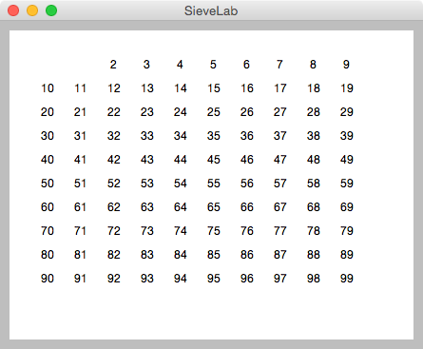
Visualization
To draw a worksheet in a graphics window pass it to a function named view_sieve:
>>> view_sieve(worksheet)
This window is called the PythonLabs Canvas

Slide 28
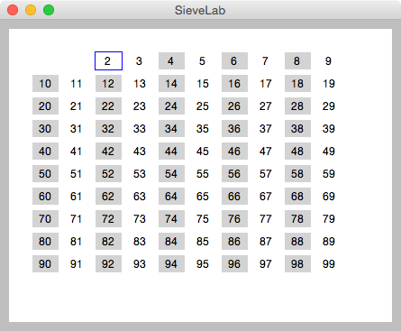
Visualization (cont’d)
Call a function named mark_multiples to see how the algorithm removes multiples of a specified value
the two arguments are a number k and the worksheet
the screen will be updated to show that k is prime (indicated by a blue square)
gray boxes will be drawn over all the multiples of k
>>> mark_multiples(2, worksheet)

Slide 29
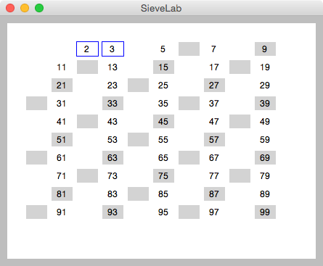
Visualization (cont’d)
Call erase_multiples to erase the marked numbers
After erasing multiples of 2, the lowest unmarked number is 3, so on the next round remove multiples of 3
>>> erase_multiples(2, worksheet)
>>> mark_multiples(3, worksheet)

Slide 30
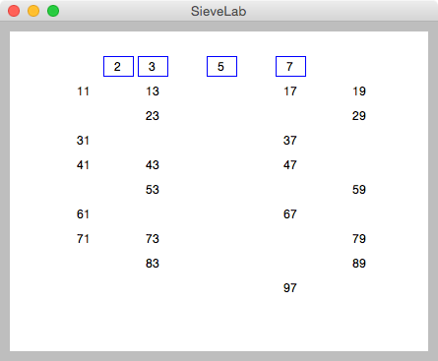
Visualization (contd)
Repeat the marking and erasing steps until only prime numbers are left
In this example n = 100
Do we need to keep going and find multiples of 11? Or are we done?

Slide 31
A Helper Function
The first step toward implementing the Sieve algorithm is to write a function that solves a small part of the problem
A function named sift will make a single pass through the worksheet
pass it a number k and sift will find and remove multiples of k
For example, to sift out multiples of 5 from the list called worksheet:
>>> sift(5, worksheet)
sift has a very specific purpose, and it unlikely to be used except as part of an implementation of the Sieve of Eratosthenes
Programmers call special-purpose functions like this helper functions

Slide 32

Stepping Through the Worksheet
On each call to sift we want to find multiples of k
The first one is 2 × k
Notice that the remaining multiples (3 × k, 4 × k, etc) are all k steps apart
We can use a for loop with a range expression to walk through the list
for i in range(2*k, len(a), k):
Note this range expression has 3 arguments: the starting point, the ending point, and the step size

Slide 33
Removing Multiples
If we want to remove a number from the worksheet we could use a Python function that deletes an item from the list
but this would shorten the list and make it harder to walk through on future iterations
Our solution: replace the items with placeholders (None objects)
The complete implementation of the sift function is shown below

Slide 34
Testing sift
Use your test editor or IED to create a new file called sieve.py
Enter the definition of sift shown on the previous slide
you can also download the text from the EiC web site
Start an interactive session and import your function:
>>> from sieve import *
Make a list to test the sift function, and print the list to make sure it has the correct values:
>>> worksheet = [None,None] + list(range(2,21))
>>> worksheet [None, None, 2, 3, 4, 5, 6, 7, 8, 9, 10, 11, 12, 13, 14, 15, 16, 17, 18, 19, 20]
The file is named sieve.py because we’ll be adding the definition of the sieve function to this file later

Slide 35
Testing sift (cont’d)
Call sift to remove multiples of 2 and print the worksheet:
>>> sift(2, worksheet)
>>> worksheet [None, None, 2, 3, None, 5, None, 7, None, 9, None, 11, None, 13, None, 15, None, 17, None, 19, None]
Call it again to remove multiples of 3:
>>> sift(3, worksheet)
>>> worksheet [None, None, 2, 3, None, 5, None, 7, None, None, None, 11, None, 13, None, None, None, 17, None, 19, None]
Is it doing what you expect?

Slide 36
The sieve Function
Now that we have a helper function to do the hard work writing sieve is straightforward
We just have to write a loop that starts by sifting multiples of 2 and keep calling sift until all composite numbers are removed
This loop can stop when the next number to pass to sift is greater than the square root of n
The for statement that controls the loop should set k to every value from 2 up to the square root of n:
for k in range(2, sqrt(n)):
When a project has helpers a function like sieve (which is called to solve the complete problem) is known as a top level function.
There is a problem here: we cannot pass a floating point value to range

Slide 37
Rounding Up
If we “round up” the square root we’ll have what we want: an integer that is greater than the highest possible prime factor of n
A function named ceil in Python’s math library does this operation
ceil is short for “ceiling”
At the top of the file we need to have a statement that imports sqrt and ceil from the math library:
from math import sqrt, ceil

Slide 38
Main Loop
One final detail: before sifting out multiples of a number make sure we haven’t already removed it
example: don’t sift multiples of 4 because 4 was already removed when sifting multiples of 2
sift would still work but our program would be inefficient
The outer loop looks like this:
for k in range(2, ceil(sqrt(n))):
if worksheet[k] is not None:
sift(k, worksheet)
The expression x is not None is the preferred way of testing to see if x is a reference to the None object

Slide 39
Remove the Placeholders
There is just one last step: to make the final list we have to remove the None objects from the worksheet
A new helper function called non_nulls returns a copy of the worksheet but without any Nones
it makes an initial empty list named res (for “result”)
it uses a for loop to look at every item in the input list
if an item is not None the item is appended to res
when the iteration is complete res is returned as the result of the function call
def non_nulls(a):
res = []
for x in a:
if x is not None:
res.append(x)
return res

Slide 40
Test the New Helper
Add the definition of non_nulls shown on the previous slide to your sieve.py file
Load the new file into an interactive session
Make a small list that contains None object and pass the list to non_nulls
Does it return a copy with all the Nones removed?
>>> from sieve import *
>>> test = [0, None, 3, None, None, 1]
>>> non_nulls(test) [0, 3, 1]

Slide 41
Complete Program
You are now ready to put all the pieces together
add the import statement that imports ceil and sqrt from the math library
add the definition of the sieve function
In the body of sieve you want to
make the worksheet with two initial Nones and all integers from 2 to n
have the for loop that calls sift
call non_nulls to remove the None objects from the worksheet
The final result is shown on the next slide

Slide 43


A New Tool for the Workbench
Now that we have a method for making lists of prime numbers we can save it for later use
We can use it to answer questions about primes
how many less than n?
largest gap between successive primes
prime pairs
Mersenne primes

Slide 44
Abstraction
This is a good example of abstraction
We have a nice, neat package that we can save and reuse
in the future we don’t have to worry about the implementation details
we (and people who use it) just need to know that sieve(n) makes a list of prime numbers between 2 and n
>>> from sieve import *
>>> p = sieve(1000)
>>> len(p) 168
>>> p[len(p)-1] 997
How many primes between 2 and 1000?
What is the largest prime less than 1000?

Slide 45
The Sieve in Practice
This project on the Sieve of Eratosthenes was motivated by the importance of prime numbers in modern cryptography
Methods like RSA use huge prime numbers -- 500 or more digits
These numbers are not generated by the sieve
there are too many prime numbers, and the worksheet would be way too long
an estimate: the number of primes less than n is n / ln n
for n = 10⁵⁰⁰ there are around 10⁴⁹⁷ prime numbers
But the sieve is an important “building block” in the RSA algorithm

